Slide 1
REDIS IN SERVICE DIAGNOSTIC

Slide 2
CONTENT
Overview
Redis
Scalability

Slide 3
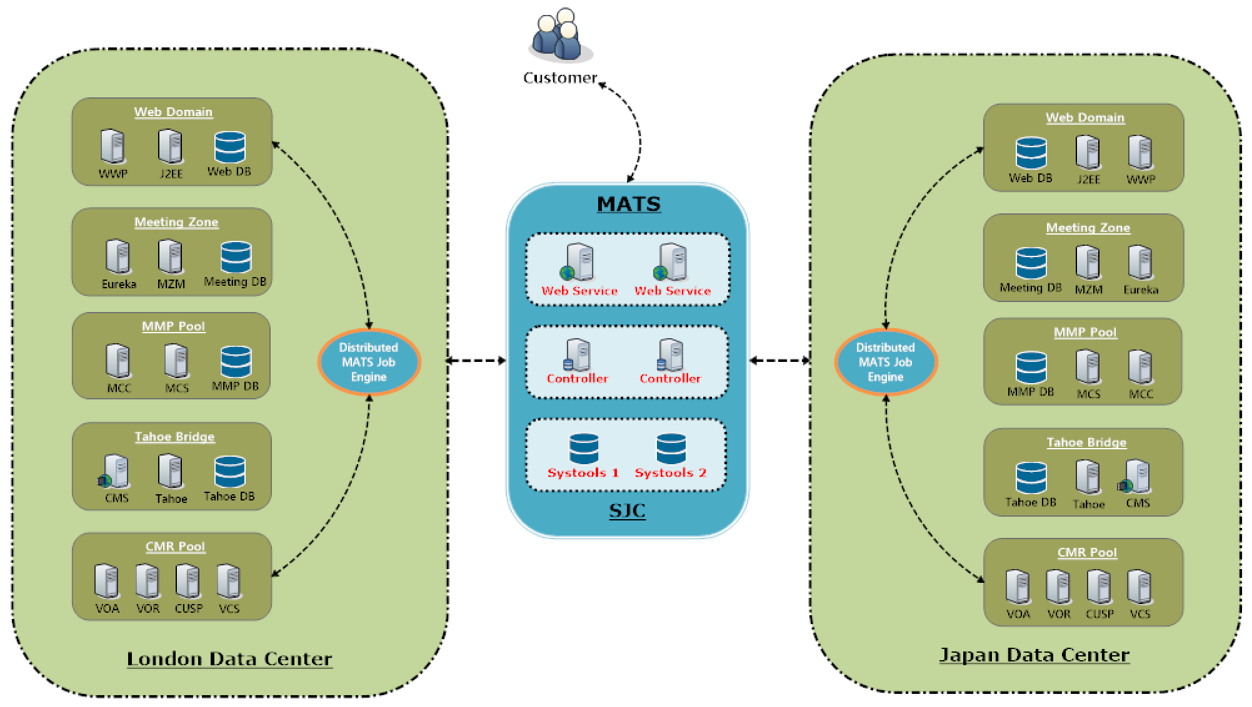
WHY REDIS?

Slide 4
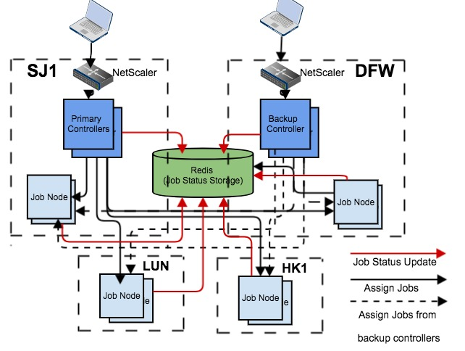
WHY REDIS?

Slide 5
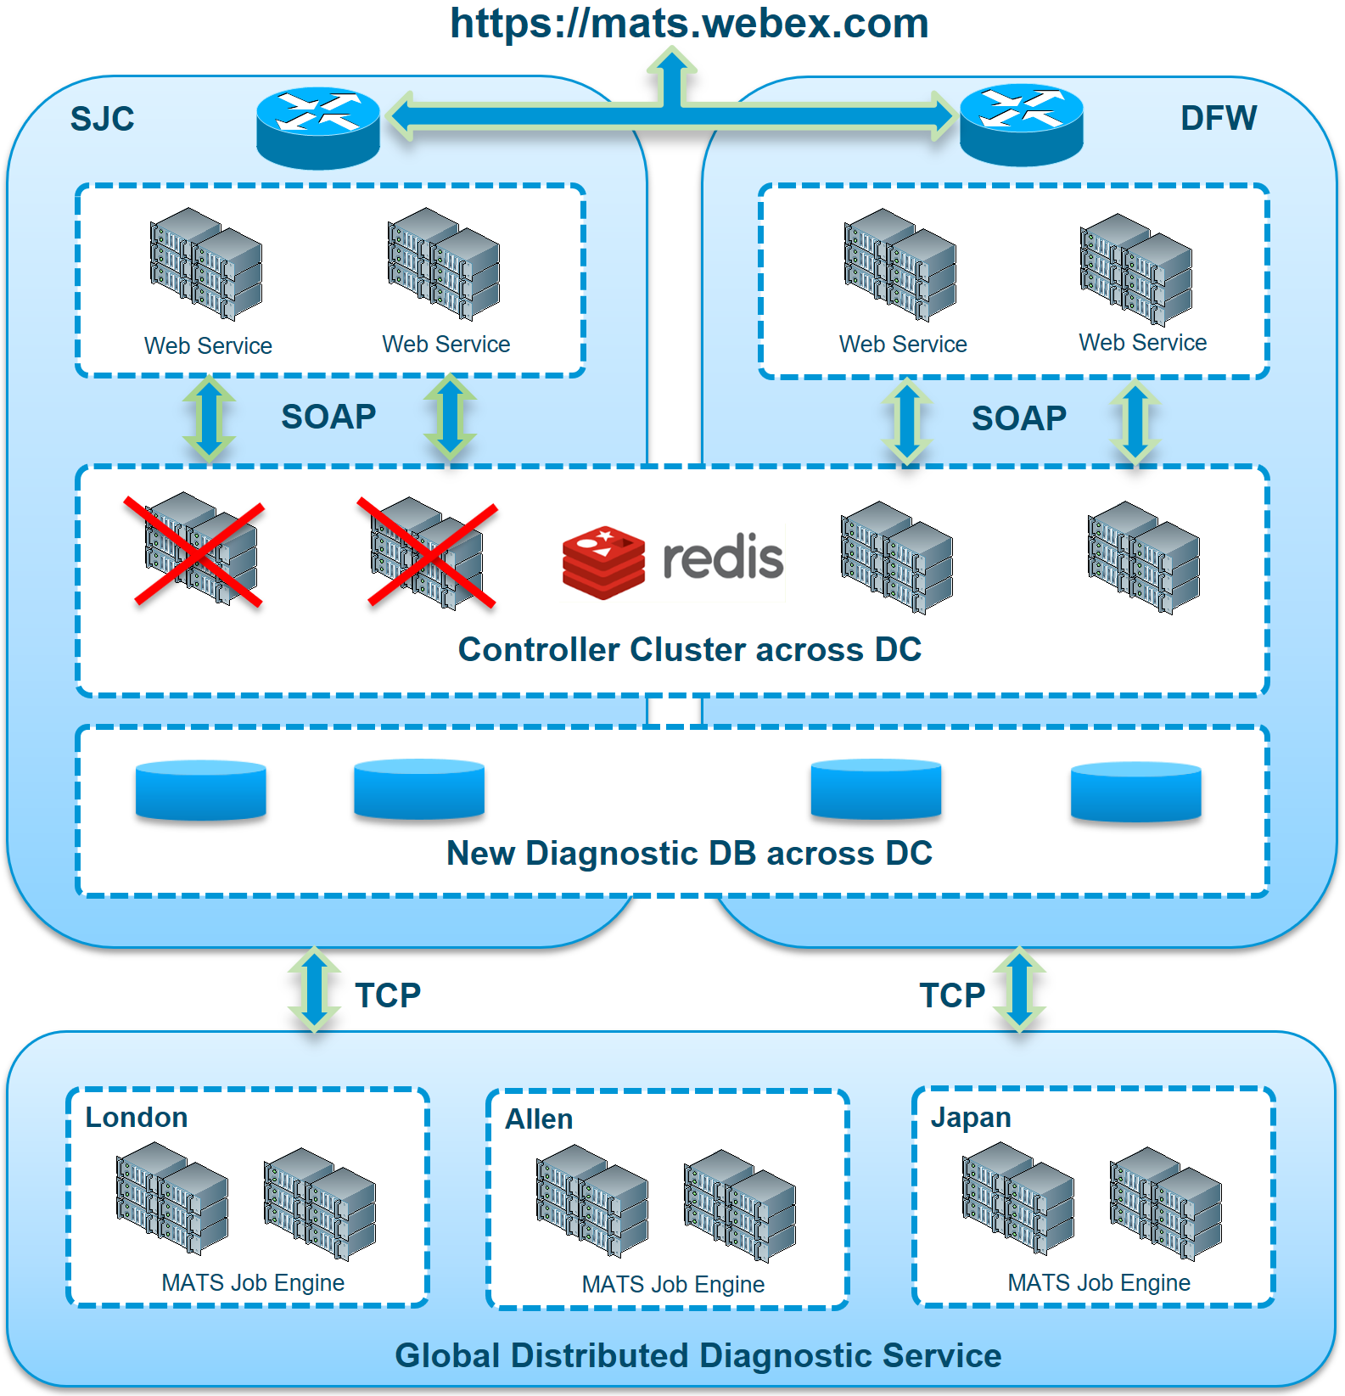
High availability across DC
WebEx Cloud
Spark Cloud
SLIM
ELK
CDS
ELK

Slide 6
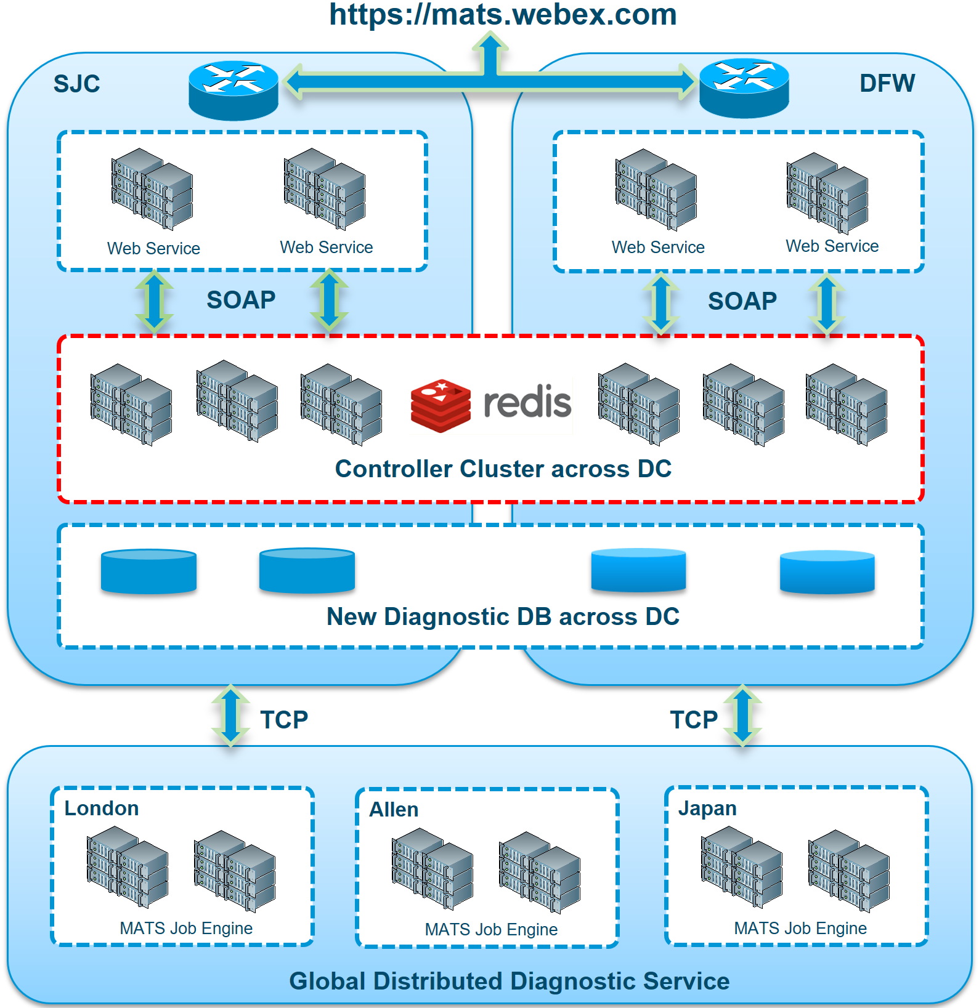
Horizontal capacity expansion
WebEx Cloud
Spark Cloud
SLIM
ELK
CDS
ELK

Slide 7
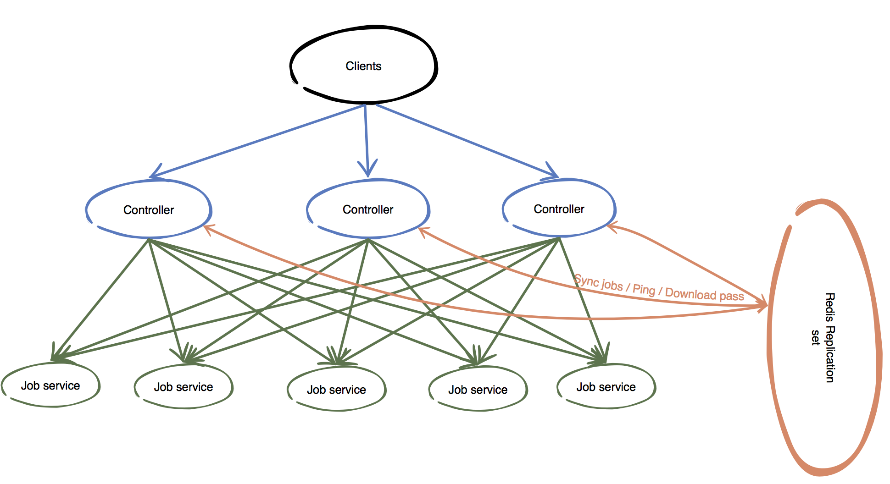
OVERVIEW

Slide 8
REDIS
Benefits
Open source, BSD licensed, advanced key-value store
Support for rich data structures
Support for persistence
High performance
Has been tested in the production environment

Slide 9
REDIS
 | Redis | Memcached
Set(multi) | ✔️ | ✔️
Get(multi) | ✔️ | ✔️
Incr/decr | ✔️ | ✔️
Delete | ✔️ | ✔️
Expiration | ✔️ | ✔️
Prepend/append |  | ✔️
Range queries | ✔️
Data types | ✔️
Persistence | ✔️
Multi-thread |  | ✔️
Replication | ✔️

Slide 10
REDIS HA
Replication
Failover
Slave
A Redis instance known as the master, one or more instances known as the slaves, become exact copies of the master.
Master
Slave
Redis
Automatic with Redis sentinel (for master-slave topology)
Automatic with Redis cluster (for cluster topology)
Manual
Redis
Redis
Redis

Slide 11
REDIS KEY FEATURES
Persistence
Partitioning
Redis provides two mechanisms to deal with persistence: Redis database snapshots(RDB) and append-only files(AOF).
Redis
Disk
Master
Breaking up data and distributing it across different hosts in a cluster.
Master
Master

Slide 12
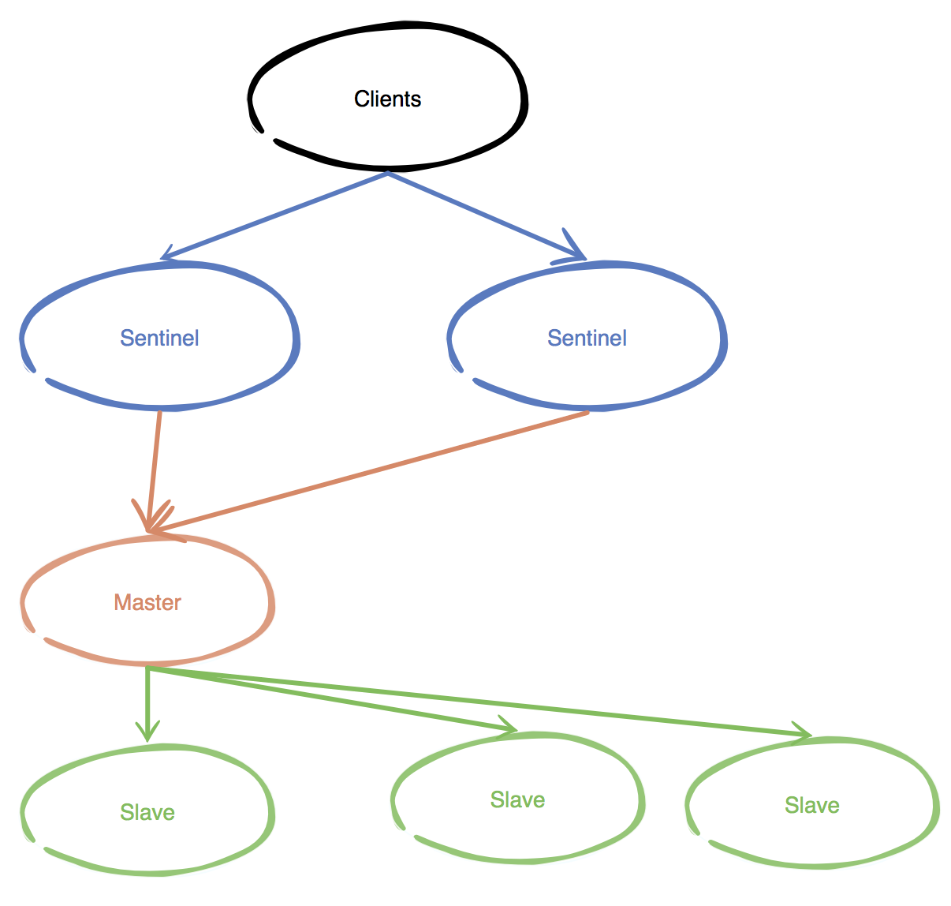
REDIS IN MATS
Master + Slave + Sentinel
SJC
DFW
monitor

Slide 13
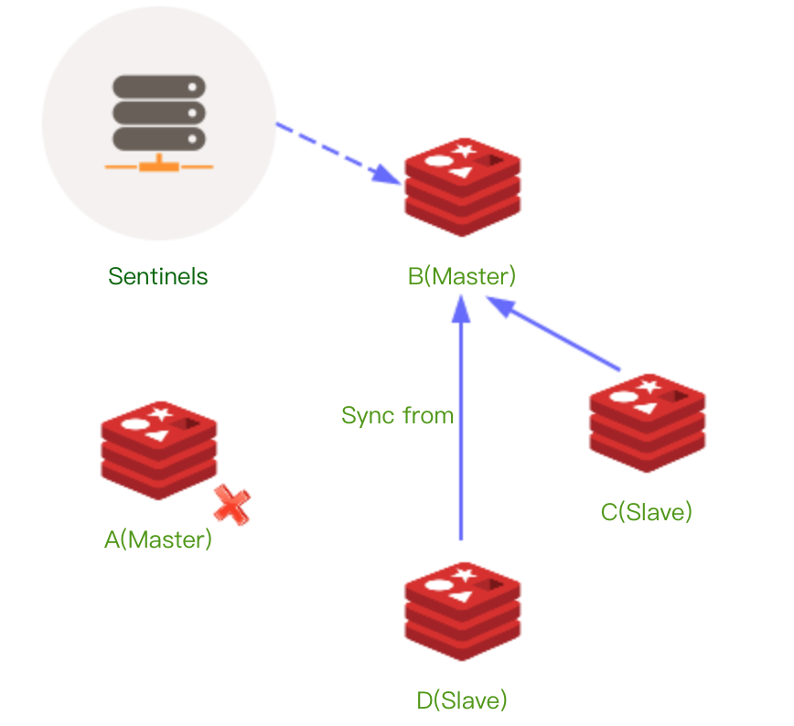
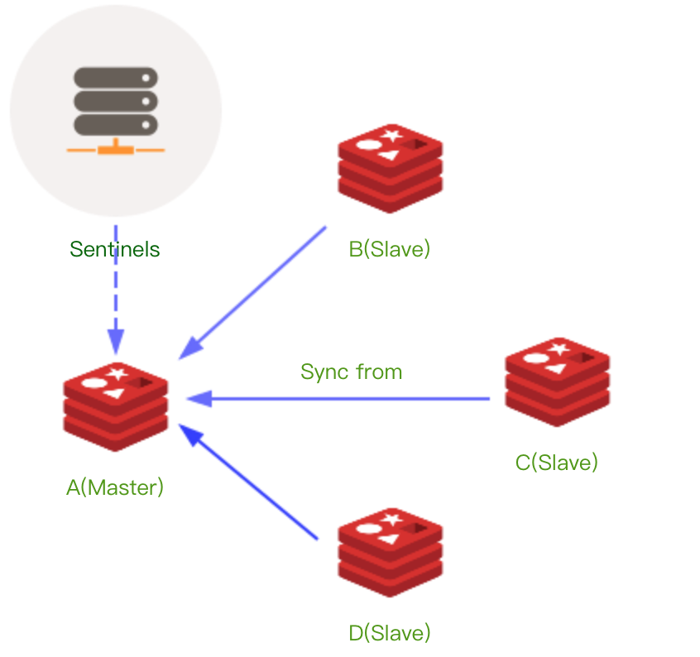
SENTINEL

Slide 14
REDIS IN MATS
GenericObjectPoolConfig config = new GenericObjectPoolConfig();
config.setMaxTotal(200); config.setMaxIdle(8); config.setTestOnBorrow(true); config.setTestOnReturn(true);
jedisPool = new JedisSentinelPool(ServerConfig.getInstance().redisMasterName, sentinels, config, 20000, ServerConfig.getInstance().redisAuth);

Slide 15
REDIS IN MATS
Transaction
Multi + Watch + Exec
jedis.watch(key);
Transaction tx = jedis.multi();
tx.set(key, "value" );
List<Object> e = tx.exec();
tx.close();
Efficiency
Pipeline
Pipeline pipeline = jedis.pipelined();
for (int i = 0; i < 100000; i++) { pipeline.set("p" + i, "p" + i); }
List<Object> results = pipeline.syncAndReturnAll();

Slide 16
no pipelining
pipelining
client
redis
client
redis
begin
begin
time
end
end

Slide 17
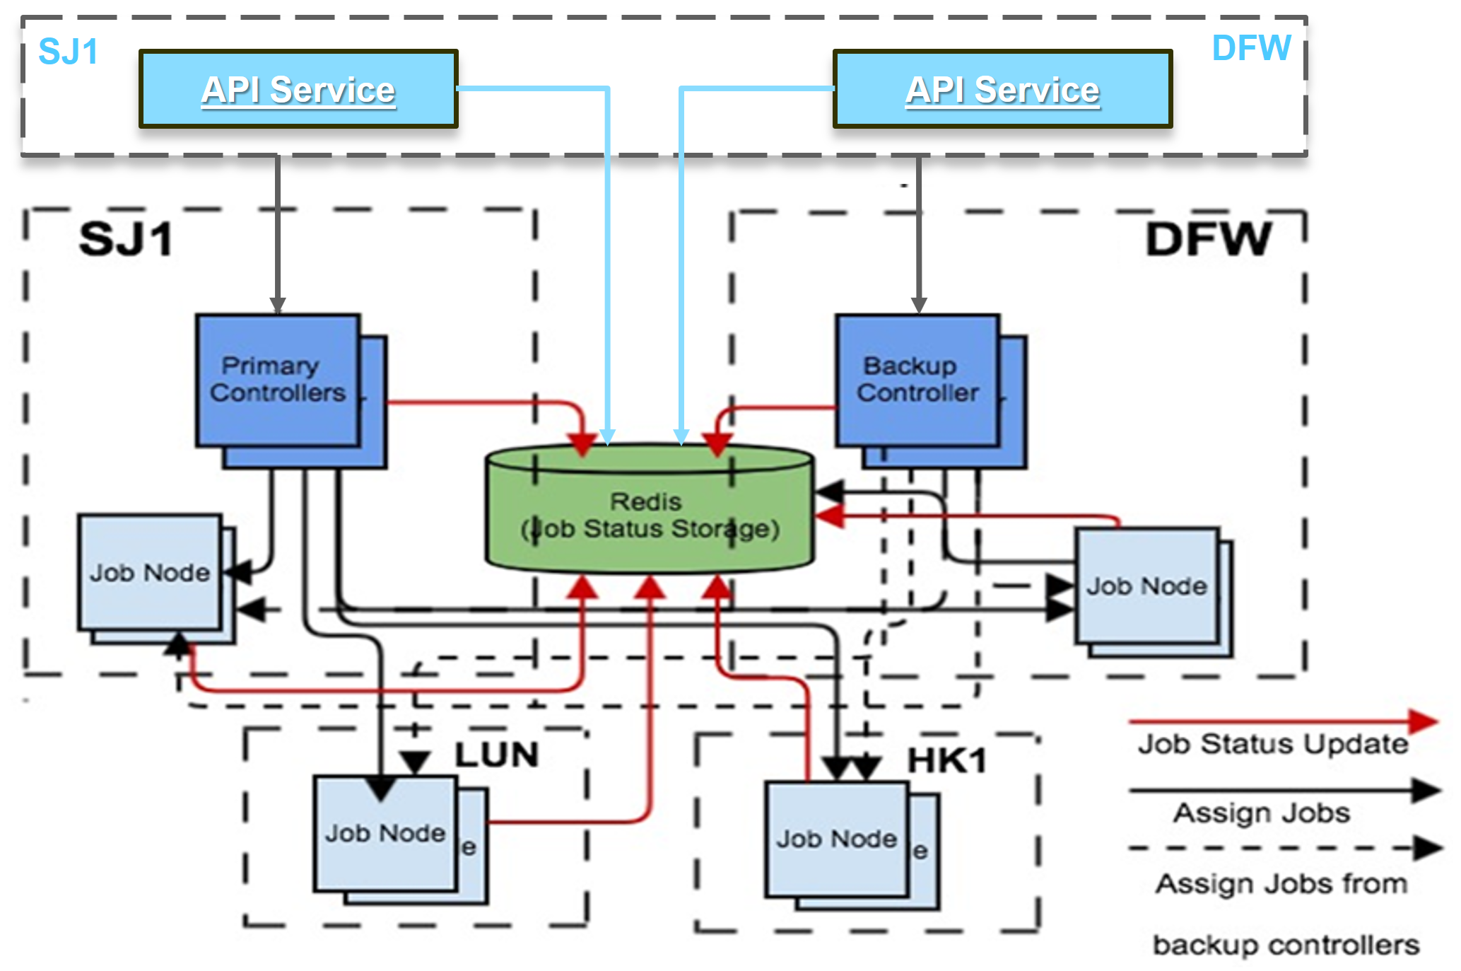

Slide 18
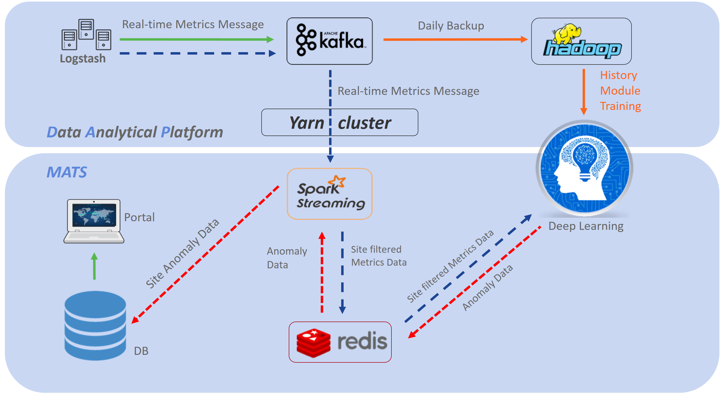
Key messages
Events
Pub-sub

Slide 19
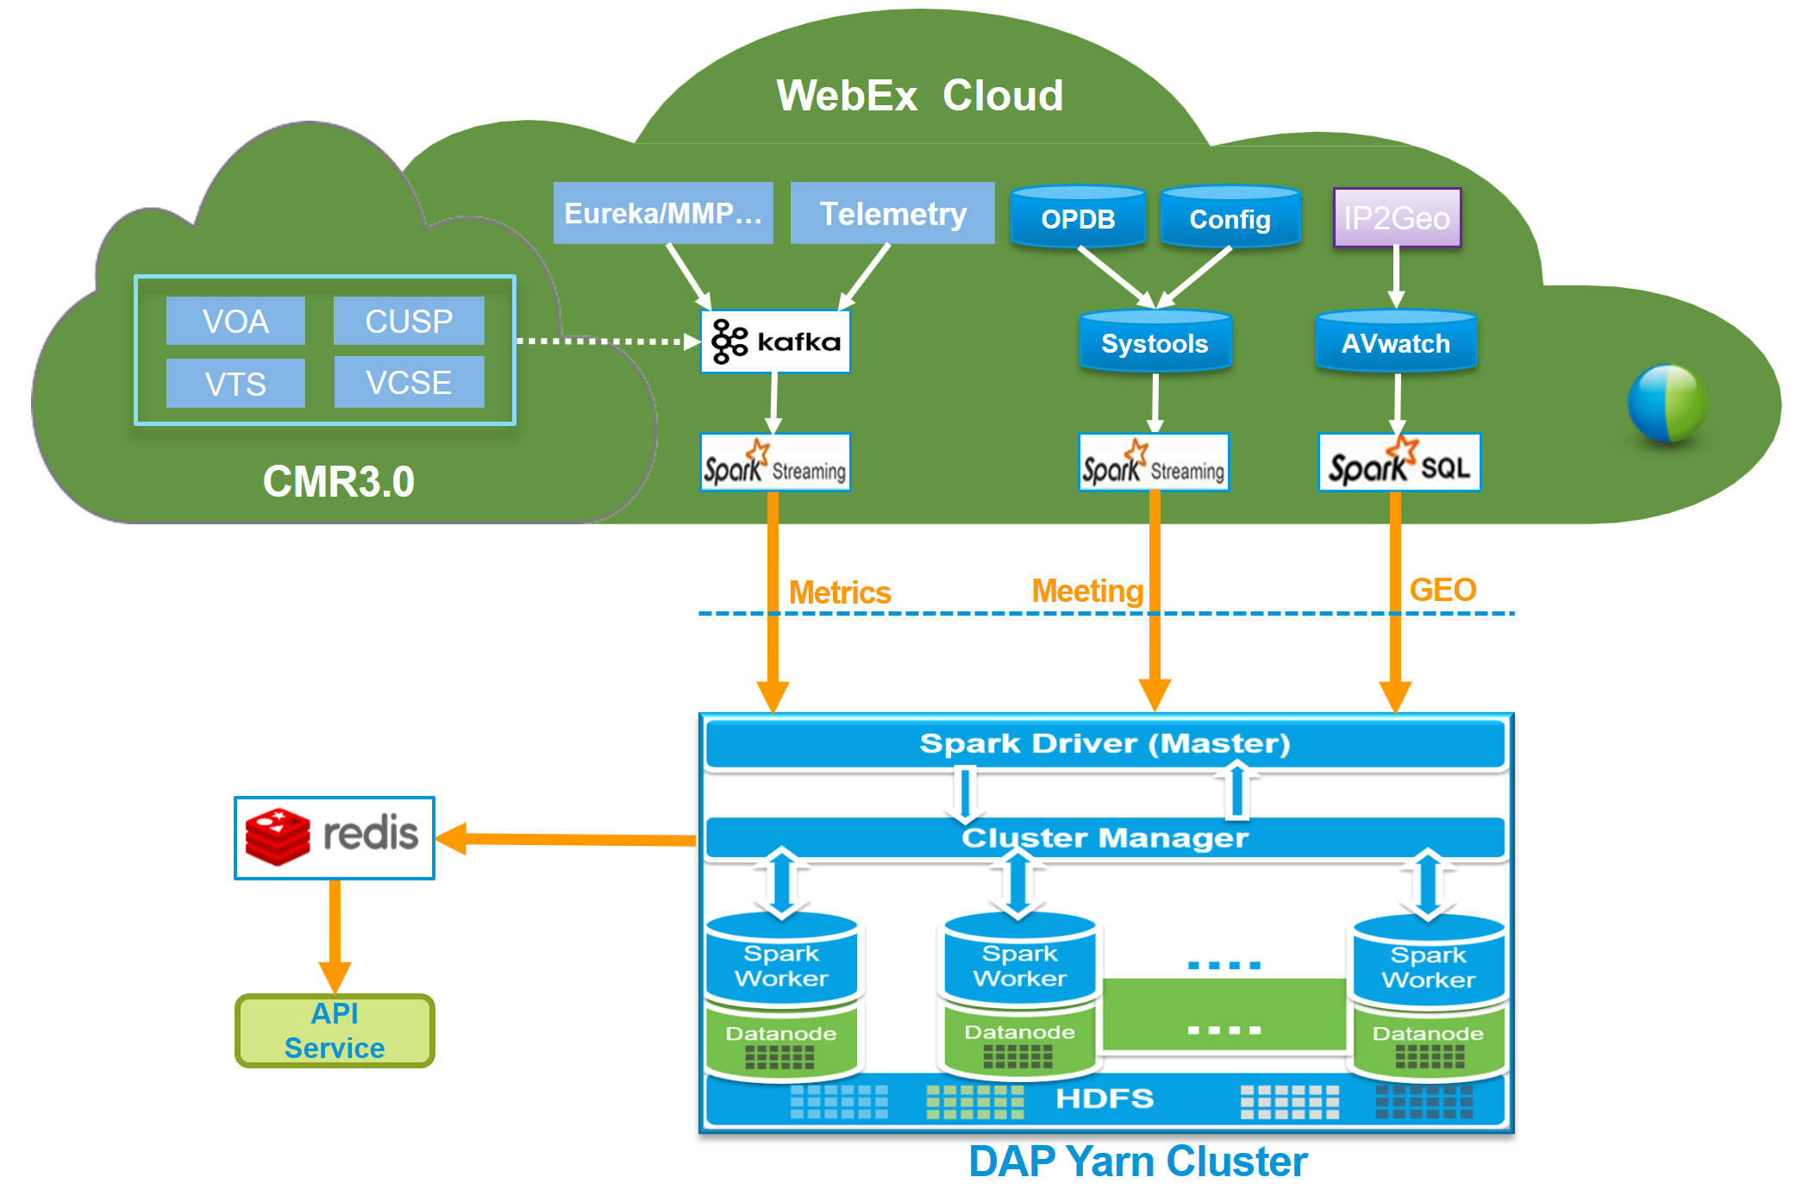

Slide 20
REDIS IN MATS
Monitor
Health check
MCT
Matrices
RedisLive
AppDynamics
NewRelic

Slide 21
REDIS IN MATS

Slide 22
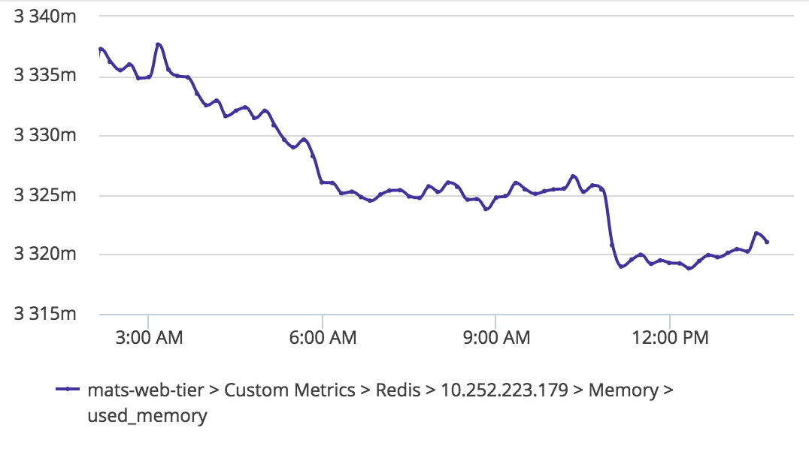
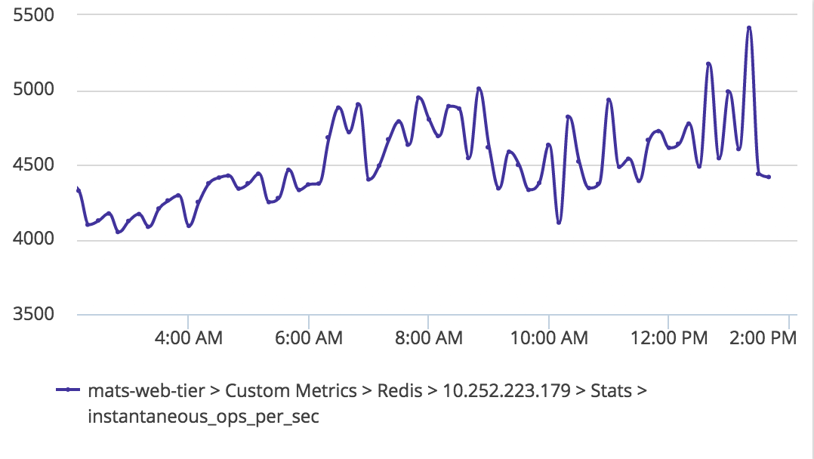

Slide 23
SCALABILITY
work list
Remove all the data synchronization between the controllers
Move all jobs to Redis, and controllers will sync with Redis at intervals
Failover & failback
Save the download pass to Redis, further reduce the pressure of the controller
Add consistency to all controllers, making controllers a cluster

Slide 24
GOSSIP PROTOCOL
A gossip protocol is a style of computer-to-computer communication protocol inspired by the form of gossip seen in social networks. Gossip spreads information in a manner similar to the spread of a virus in a biological community.
Gossip is a consistency algorithm that can guarantee final consistency
3 communication methods
Push
Pull
Push / pull
Fault tolerance, decentralization, flexibility expansion

Slide 25
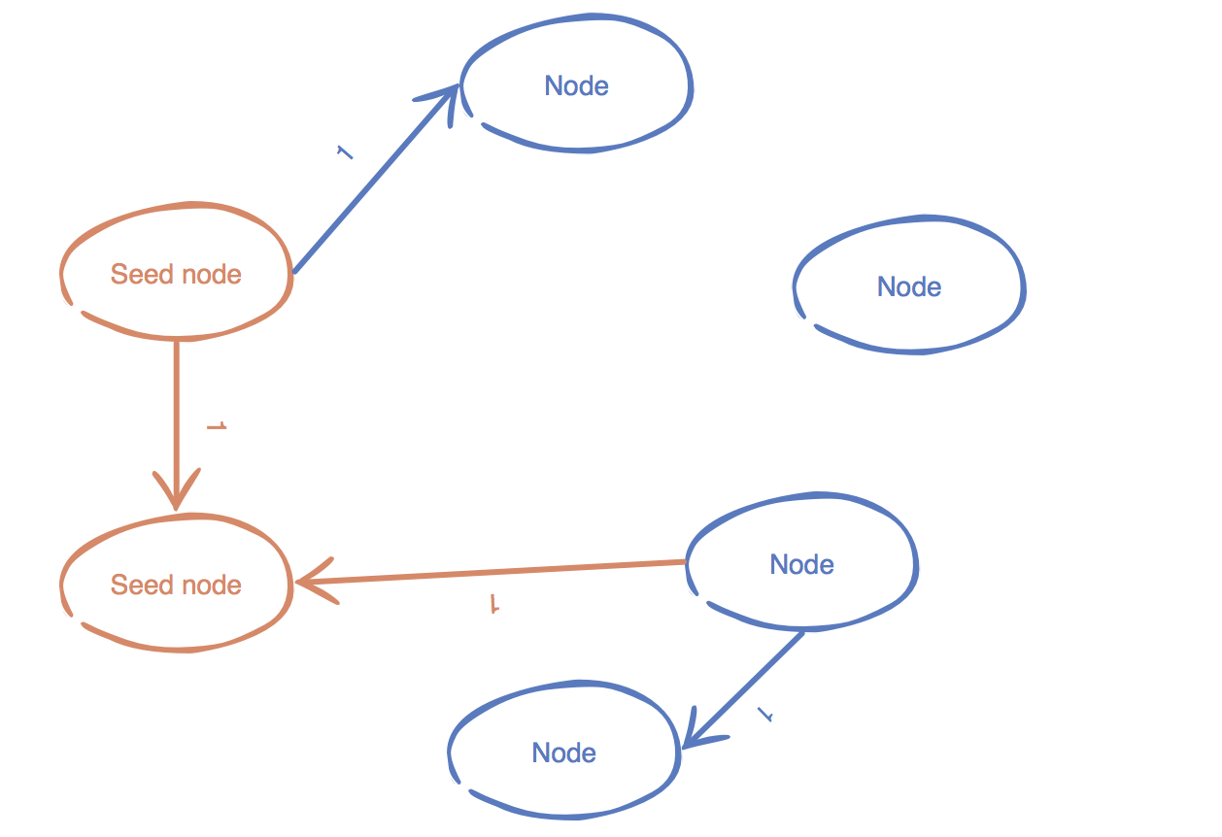
GOSSIP PROTOCOL

Slide 26
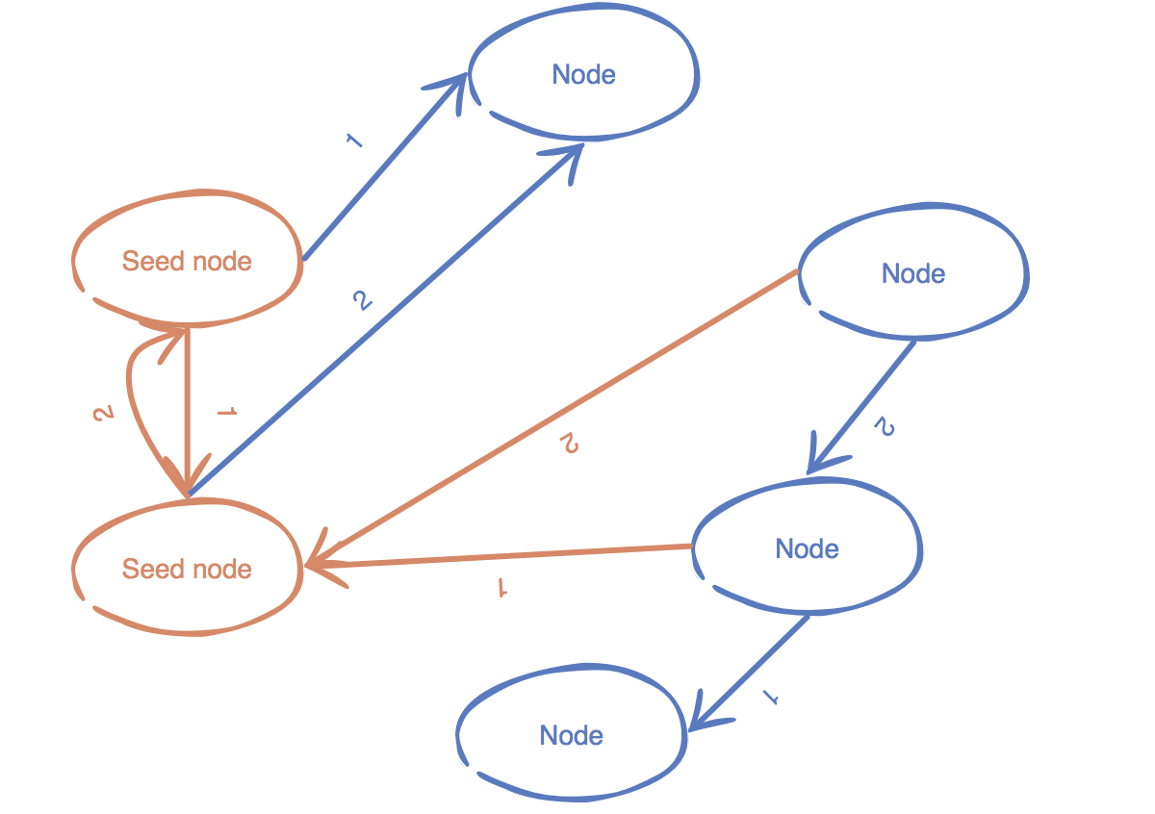
GOSSIP PROTOCOL

Slide 27
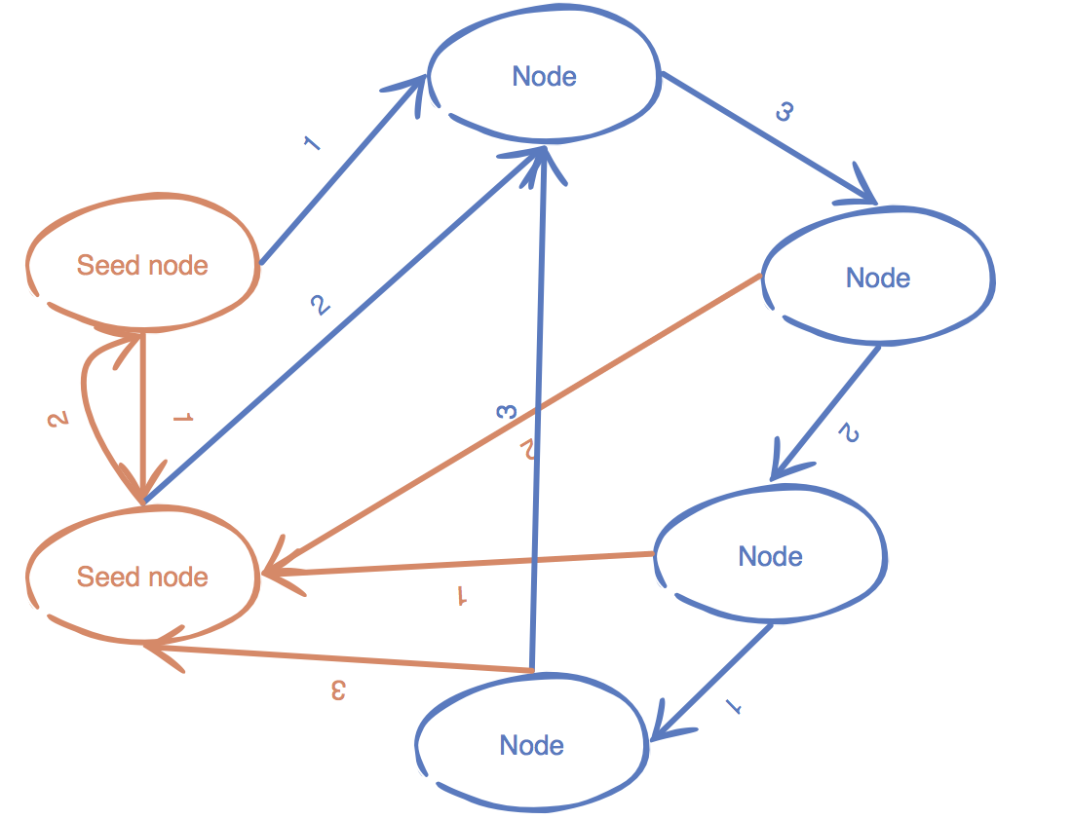
GOSSIP PROTOCOL

Slide 28
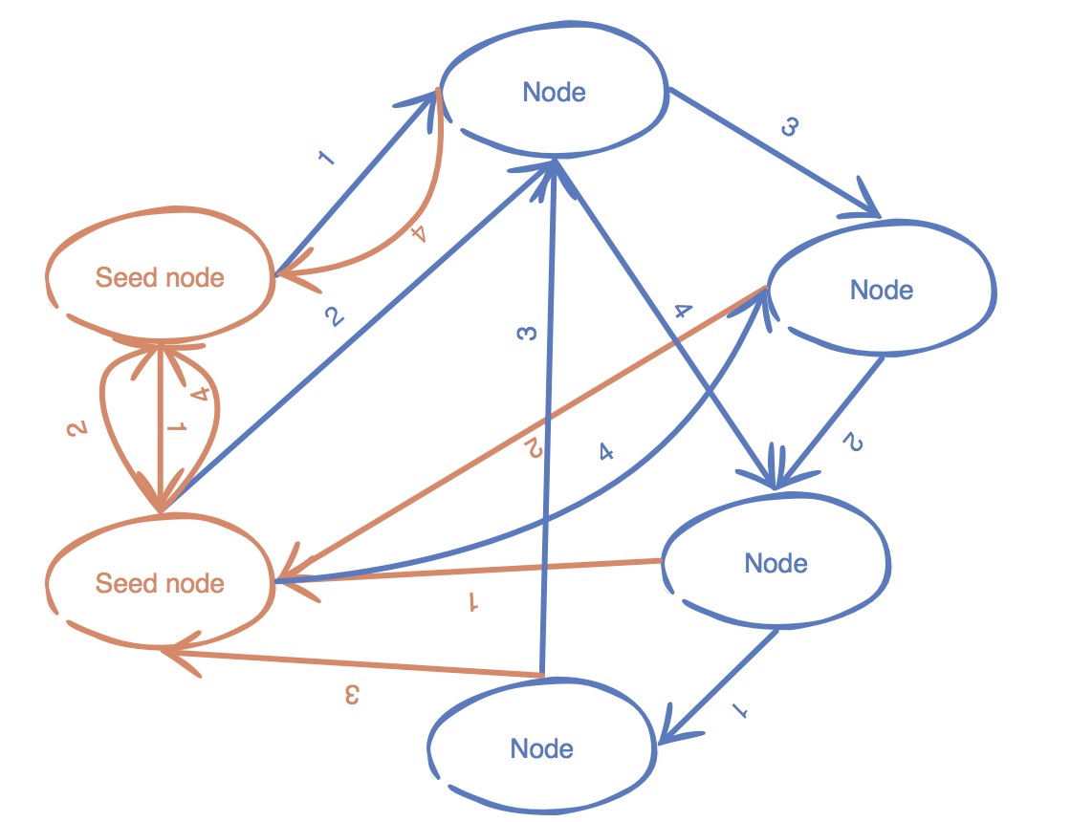
GOSSIP PROTOCOL

Slide 29
COMMUNICATION MESSAGE
A normal cluster
live member : [GossipMember{cluster='logservice_gossip_cluster_ATS', ipAddress='10.240.1.128', port=37000, id='10.240.1.128:18188', state=UP}, GossipMember{cluster='logservice_gossip_cluster_ATS', ipAddress='10.240.225.18', port=37000, id='10.240.225.18:18188', state=UP}, GossipMember{cluster='logservice_gossip_cluster_ATS', ipAddress='10.240.162.185', port=37000, id='10.240.162.185:18188', state=UP}, GossipMember{cluster='logservice_gossip_cluster_ATS', ipAddress='10.240.225.19', port=37000, id='10.240.225.19:18188', state=UP}, GossipMember{cluster='logservice_gossip_cluster_ATS', ipAddress='10.240.1.129', port=37000, id='10.240.1.129:18188', state=UP}, GossipMember{cluster='logservice_gossip_cluster_ATS', ipAddress='10.240.162.188', port=37000, id='10.240.162.188:18188', state=UP}] dead member : []

Slide 30
COMMUNICATION MESSAGE
An unusual cluster
live member : [GossipMember{cluster='logservice_gossip_cluster_ATS', ipAddress='10.240.1.128', port=37000, id='10.240.1.128:18188', state=UP}, GossipMember{cluster='logservice_gossip_cluster_ATS', ipAddress='10.240.225.18', port=37000, id='10.240.225.18:18188', state=UP}, GossipMember{cluster='logservice_gossip_cluster_ATS', ipAddress='10.240.162.185', port=37000, id='10.240.162.185:18188', state=UP}, GossipMember{cluster='logservice_gossip_cluster_ATS', ipAddress='10.240.162.188', port=37000, id='10.240.162.188:18188', state=UP}] dead member : [GossipMember{cluster='logservice_gossip_cluster_ATS', ipAddress='10.240.225.19', port=37000, id='10.240.225.19:18188', state=DOWN}, GossipMember{cluster='logservice_gossip_cluster_ATS', ipAddress='10.240.1.129', port=37000, id='10.240.1.129:18188', state=DOWN},]

Slide 31
Thank you

